Slide 1
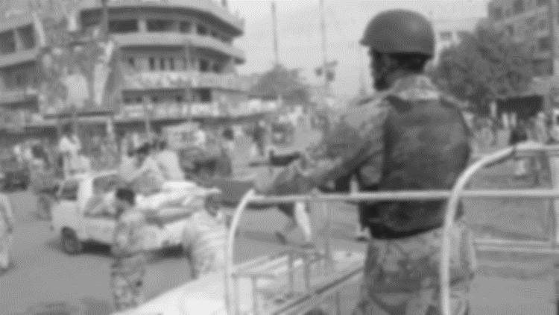
Operation Blue Fox

Slide 2
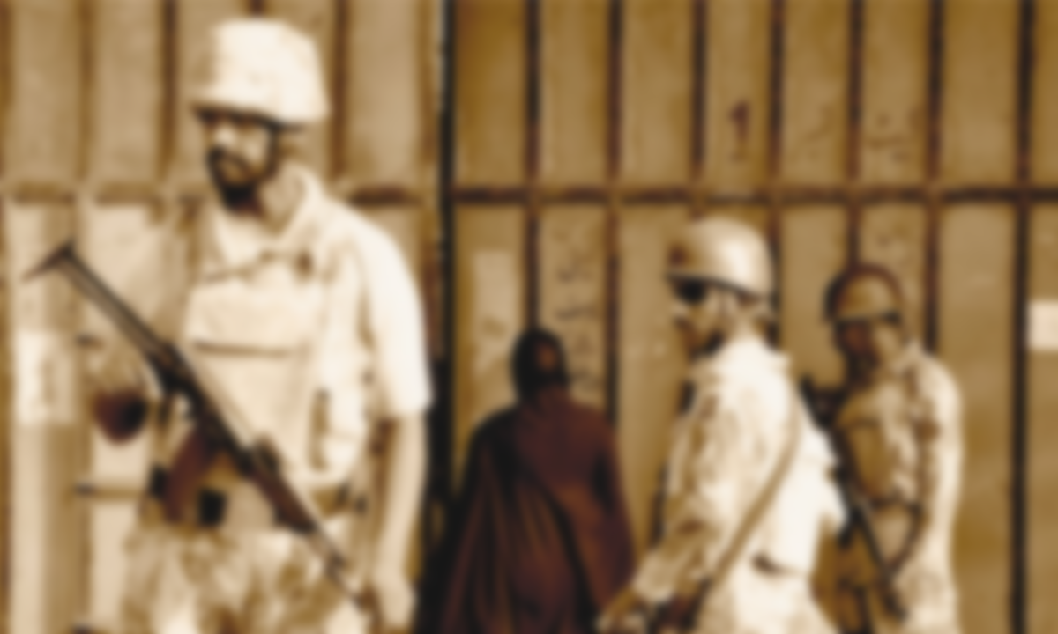
Introduction
An armed military intelligence programme known as Operation Clean-up, also known as Operation Blue Fox, was run by the Sindh Police and Pakistan Rangers with support from the Pakistan Army and its affiliated intelligence organisations. Prime Minister Nawaz Sharif's orders, which were planned by the FIA and Intelligence Bureau, were put into action in 1992. Its goal was to "purge" Karachi of "anti-social" components. In response to the issue surrounding the Jinnahpur proposal, which purportedly aimed to have Karachi secede from Pakistan, the show singled out the Muttahida Qaumi Movement.

Slide 3
Causes and Plan
Under Brigadier (retired) Imtiaz Ahmed, Director-General of the Intelligence Bureau, studies for an Army-led operation in Karachi were completed in 1992, and he recommended the plan under the codename Operation Clean-up. On the personal initiative of Prime Minister Nawaz Sharif, Imtiaz Ahmed and the Pakistan Rangers launched the Clean-up procedure, focused on taking action against dacoits in rural Sindh rather than certain political parties, but it effectively became a hunt against the MQM. The MQM’s activist leader, Altaf Hussain, was forced into exile, and the party which had dominated Karachi politics since its founding in 1984 was forced underground. The program's protocol, according to the sources, was supposed to run six months, with a deadline of June 1992.

Slide 4
Killings in hyderabad
On September 30, 1988, dozens of people, mostly Muhajir, were killed in Hyderabad, Sindh in what was known as "Black Friday". Death tolls ranged from 1000+ to 1050+ , and the attacks are said to have been coordinated and carried out by militants of the Sindh Taraqi Pasand Party. Unidentified gunmen opened fire on large crowds of innocent bystanders, including women and children in Latifabad near Pakistan Army deployments in Board Stadium unit No.6.
Sindhi nationalists, including (Sindhi Baloch) Qadir Magsi (SOB) and the Sindh Taraqi Pasand Party, were widely seen as responsible for the massacre.
The following day there was ethnic rioting which killed at least 1000+ people in Karachi. A curfew was enforced in both Karachi and Hyderabad.
Moreover, the Pakka Qilla operation in May 1990 added fuel to the fire.

Slide 5
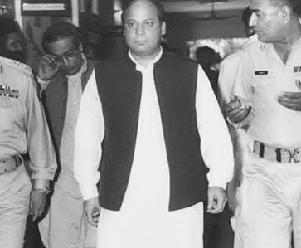
Prime minister Nawaz Sharif along with Chief of Army Staff General Asif Nawaz and V Corps GOC-in-Chief Lieutenant General Naseer Akhtar visiting General Headquarters (GHQ) to get briefing on 19th June of 1992 Operation preparations. Its objective was to "cleanse" Karachi city of "anti-social" elements.

Slide 6
Implementation
The programme was put on hold after Nawaz Sharif was removed from office, but it was revived following the 1993 general elections, which saw Benazir Bhutto take power and the MQM win the provisional elections decisively. The proposal was made, and Benazir Bhutto renamed the program's protocol "Blue Fox" in 1993 and persuaded the programme more aggressively. The Jinnahpur affair and the Major Kaleem Case in Karachi in 1993 were two of the reasons given for the launch of the Blue Fox. With the PPP's controversial decision to form Malir District in 1994, the street fighting with the PPP continued in rural Karachi.

Slide 7
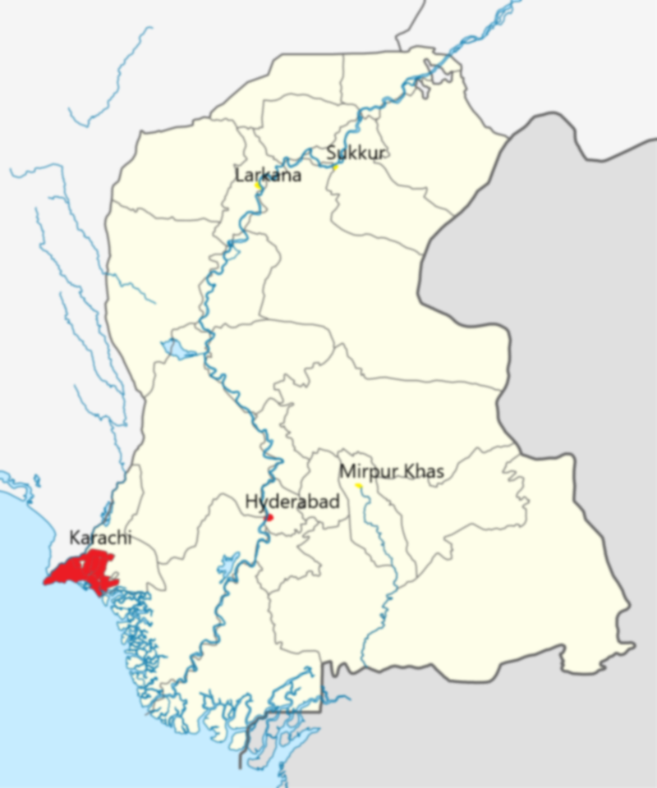
Jinnahpur plan
During the 1992 Army operation, the MQM was accused of being anti-Pakistan, besides being alleged of hatching a conspiracy to establish a separatist state by the name of “Jinnahpur”.
Numerous national newspapers and media outlets had reported that Brigadier Asif Haroon of Pakistan Army had called journalists from Punjab after the launch of the 1992 operation and had briefed them about the “Jinnahpur Conspiracy.”
As reported by a large section of the national Press about 23 years ago, Brigadier Asif Haroon had stated that the maps of the break-away state “Jinnahpur” and other documents were recovered from the MQM offices. But on October 19, 1992, the same national newspapers had carried an ISPR press release, conveying Army’s denial of the knowledge of the “Jinnahpur” plan.
The ISPR had stated that the Army had no evidence concerning the so-called Jinnahpur plan and newspaper stories in that context were baseless, maintaining that the Army had neither handed over to the government any document or map as reported, nor was it in the possession of any evidence concerning the so-called “Jinnahpur Plan”. The ISPR had clarified that it was also wrong that the matter was discussed at any meeting of the Karachi Corps Commander.

Slide 8
The Final phase
The anti-MQM operation continued into the new Benazir Bhutto government. The army’s search and destroy operation led to the discovery of arms caches and torture chambers in Karachi.
Ending in 1994, the period is regarded as the bloodiest period in Karachi’s history, with thousands killed or gone missing in the fighting. According to some reports, cited by dialogue Pakistan almost 18000 workers were killed. Thousands were arrested and brutally tortured. According to Altaf Hussain, the ‘Operation-cleanup’ commenced against 72 big fishes, to put an end on the rising terrorism, but it targeted MQM specifically.
In May 1995, arm clashes again broke out between the MQM and the Sindh Police managed by the PPP. However, Benazir Bhutto’s steps towards the counterinsurgency did bring some calm in Karachi by the spring of 1996.

Slide 9
Over this issue, Murtaza Bhutto, brother of Benazir Bhutto was notably gunned down in a police encounter with the Sindh Police, some reports also say that his verbal disagreement with PPP and his stance over the ongoing corruption led to his death. Within seven-week, President Farooq Leghari dismissed the government of Benazir Bhutto, primarily charging the issue of Murtaza Bhutto and the killings of MQM workers. MQM again participated well in 1997 general elections and redemonstrated its political leverage in the parliament. Furthermore, the program came to its final halt in end years of 1996 after the dismissal of Benazir Bhutto’s government.
The MQM hold prayers for its deceased workers at the Lal Qila Ground. More than 20 years have passed since the alleged arrest or disappearance of MQM workers, families of the missing people are still hopeful for justice after registering the cases in the Supreme Court of Pakistan. This operation came to an end and according to police cheif of karachi, shoaib suddle, this operation concluded with no results.

Slide 10
Aarib
Abdur Rehman
Arham
Maasir
Zamin
Thank You

